Slide 1
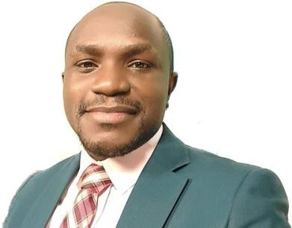
PEB0144
23RD INTERNATIONAL AIDS CONFERENCE 6-10 JULY 2020
The frequency and yield of cryptococcal antigen screening among anti-retroviral therapy (ART) naïve and ART-experienced HIV-infected patients in rural Uganda Joseph Baruch Baluku^{1,2}, Pallen Mugabe¹, Shem Mwebaza¹, Jane Nakaweesi¹, Catherine Senyimba¹, Barbara Mukasa¹
¹ Mildmay uganda, Wakiso, Uganda, ² Mulago National Referral Hospital, Kampala, Uganda
4
5
1
Background
Results
Conclusion
The yield of cryptococcal antigen (CrAg) screening , a predictor of cryptococcal meningitis, among anti-retroviral therapy (ART)-experienced people living with HIV (PLHIV) is not well established in programmatic settings.
There was a low frequency of screening but a high yield of CrAg positivity among ART-experienced PLHIV with suspected virological failure.
PLHIV eligible for CrAg screening
10.0%
16.4%
ART experienced group (n = 7,210)
6
2
Objective
ART naïve group (n = 937)
Recommendations
We compared the frequency and yield of CrAg screening among newly diagnosed PLHIV with CD4<100 cells/mm3 (ART-naïve group) and ART-experienced PLHIV with suspected virological failure (viral load >1000 copies/ml) (ART-experienced group) attending rural public health facilities in Uganda.
There is a need for a guideline recommendation for CrAg screening among PLHIV with suspected virological failure
Cost-effectiveness studies for CrAg screening among PLHIV with suspected vrirological failure are needed.
PLHIV Screened for CrAg (Frequency of screening)
11.5%
95.1%
p< 0.001
ART experienced group (n = 830)
ART naïve group (n = 891)
3
Methods
We analysed data from publicly available programmatic reports on CrAg screening from 107 health facilities in 8 rural districts in Uganda from January 2018 to July 2019. We compared the frequency and yield of CrAg screening between the two groups using Pearson's Chi-square test
PLHIV with positive CrAg (Yield of screening)
10.5%
7
13.8%
PRESENTER
p=0.035
Dr. Joseph Baruch Baluku Mildmay Uganda, PO Box P.O Box 24985, Kampala, Uganda joseph.baluku@mildmay.or.ug +256706327972
ART naïve group (n = 123)
ART experienced group (n = 87)
This project has been supported by the President’s Emergency Plan for AIDS Relief (PEPFAR) through CDC under the terms of 1NU2GGH002046-01-00

